Slide 1
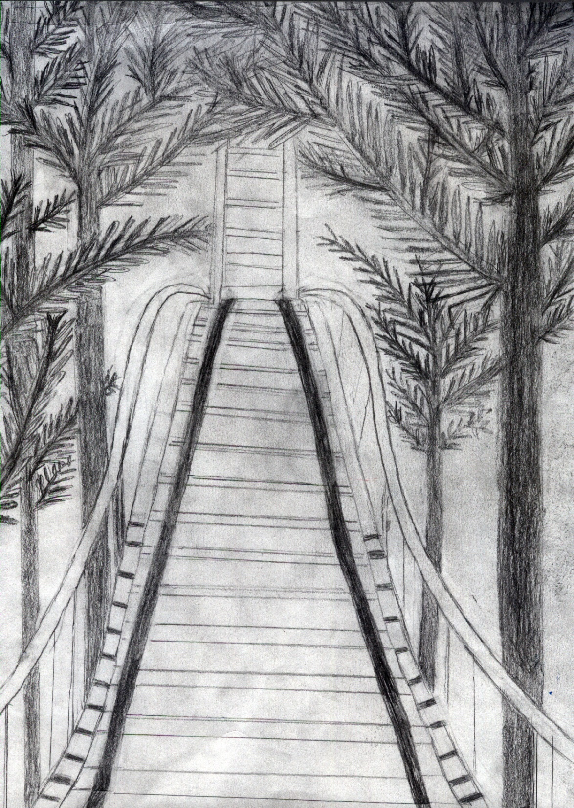
Roller Coasters
Notes:
Click, click, click. The roller coaster slowly approaches its peak. The rider’s adrenalin is rushing; their heart is pounding out of their chest. Suddenly there is a pause, the coaster reaches the peak. The coaster then rushes downs the drop. Everyone throws their arms up and screams. Roller coasters are thrill seeking adventure rides that are used all over the world today for a source of fear and excitement. Imagine what we would do without them?
Good morning, my name is marisa carlucci and my exhebition topic is on roller coaster.

Slide 2
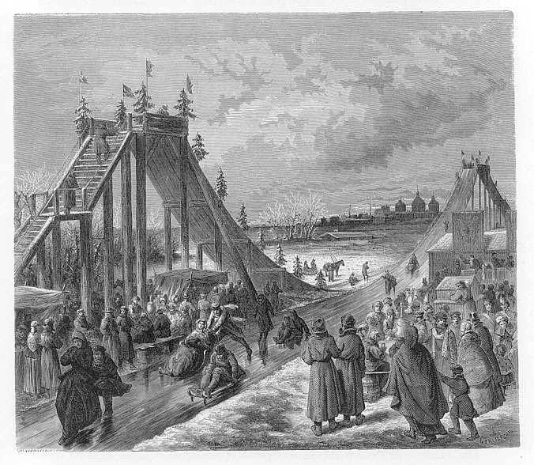
Before
Russian Ice slides
Dangerous
Catherin The Great
Notes:
-17th century Russia.
-huge- stretched up to 85 ft tall
-For fun: excitement/thrill to ppl
-tall wooden structure coated with ice over a long sloping ramp.
-There was a staircase that led to the launch area.
-Rider road in sled made of ice- occasionally wood.
-There was a rope drilled through the ice block, acting as a handle for the rider to hold onto.
-top of sled- fur or hay was placed.
-At end of the slide, pile of sand was placed to slow rider down & to prevent them from crashing/getting injured.
-Occasionally bumps added at the end of slide
-The slides were placed in parallel pairs, but they were facing opposite directions so that when the rider reached the end of one slide they could take the staircase right up to the other.
-Although very popular and entertaining they were also dangerous.
-Took lots of ajility & cordinanetion
-Accidents were common
-These ice slides were most popular during winter festivals.
-Catherine the great enjoyed riding on ice slides, she even had some private slides built on her own property.
-During the time Russian ice slides were popular, a French businessman decided to take the idea and pursue it in France.

Slide 3
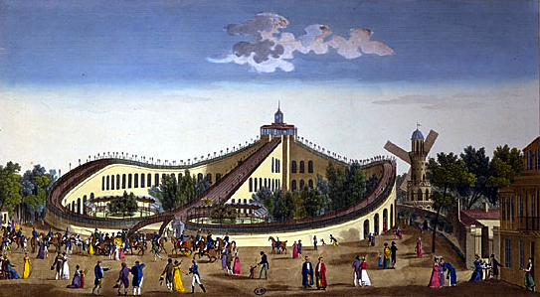
Origins
French Business man
France- unsuitable weather
Weather proof
Notes:
-A French business man took the idea of ice slides and attempted to build them in France.
Name is unknown.
He wasn’t successful, the weather was too warm for the ice slides.
Ice on the slides started to melt. Some residents even called this a “slurpee slide in mockery of the ice slide.
French businessman was not discouraged.
The disaster of the mushy wet ride inspired the next step of the evolution of roller coaster.
He made the decision to build an all-weatherproof version of the Russian slide.
Made of waxed wooden slopes & hills.
The sled that went along with this weatherproof slide was a wood sled with rollers on the bottom.
Skill was also needed to drive these sleds, just like the ones in Russia, so accidents were just as common.
Strangely, the more accidents these early French rides had, the more people were drawn to them.
The wealthier class of people in Russia had private indoor models built.
The accidents on the rides were too much of a problem, so that’s when the idea of a track came upon them.
In 1817 a ride that locked the sleds was made. The solution to all these accidents finally came upon them.
It was named, Les Montagues Russes a Bellevilles.
This ride was the world’s very first roller coaster.

Slide 4
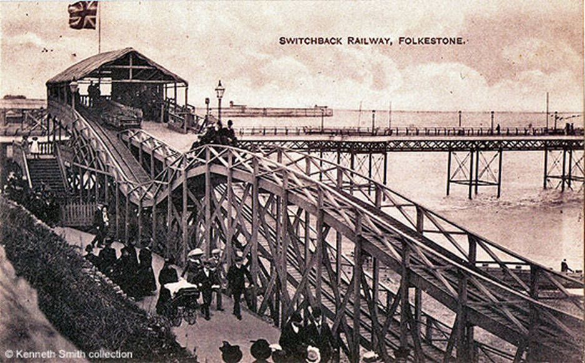
Origins
Mauch Chunk Railway
Switchback railway
Notes:
-The Mauch Chunk Railway was the American beginnings of the roller coaster.
-Started out as a transportation system for the coal mining industry.
-Coal mines in the area had one problem, how to cheaply and effectively transport the coal from mines on the top of the mountain, to the port in Mauch Chunk.
-to solve this transportation problem, a railway was then built.
-The track went 18 miles down hill and the carts traveled purely by gravity.
-The only thing that the workers had to do was load the cars with coal then push them off the top of the mountain.
-To haul the empty carts back to the top of the track, mules were employed.
-Later on, a car was built for the mules so that they could ‘ride’ down with all the coal, and then take the empty cart back up the track.
-Then someone got the idea to load the mine cars with people, then push the people down the hill.
-The person that thought of this idea to load the carts with people was not recorded in history.
-The track became a huge success, it was used for coal mining in the day and a roller coaster rides at night.
-To replace the mules, a steam engine was installed to carry the carts to the top of the track.
-The people paid one dollar to ride up on the motorized track.
-They were then sent down the other track with only gravity to push them.
-In 1870 the coal miners moved to a shorter railway, and that left Maun Chunk Railway only for roller coaster rides.
-A hotel and a restaurant were even built on the top of the mountain.
-This ride continued until the mid 1930s with an outstanding safety record.
Switchback
-Built in 1890’s.
-The switchback railway was one of the first early true roller coasters.
-This ride was built of wood, on a wooden structure.
-The riders would climb up a flight of stairs to board the coaster car.
-The coaster car was then pushed out of the station.
-The cart would run over a couple bumps until it ran out of momentum to push it.
-Next the riders would exit, and walk up another flight of stairs while the workers horsed the car back to the top of the seconded station.
-There was an identical course going in the opposite direction, the riders got back in and road back to the first station.
-Then somebody made a u-shaped version of the switchback railway that did not include the mid-coarse switchback.
-The ride, known as a roller coaster, was born.
url for pic- http://www.andrewsgen.com/matlock/pix/ks/switchback_folkstone3.jpg

Slide 5
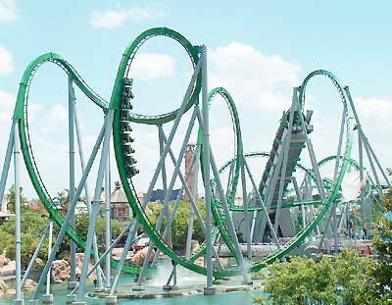
Types of Roller Coasters
Wood
Steel
Non-looping
Shorter/Slower
Chain
Looping
Taller/Faster
Cord
Notes:
-When comparing wood and steel coasters,
-wood coasters don't make loops/ steel do.
-Wood roller coasters usually are not as tall or fast as steel ones.
-Most wood coasters don't feature very steep drops, or as long as a track as steel ones do.
-Wood- chain, click
-Steel- cord, smoother/more enjoyable ride
-Cords are newer
-Cord & chain both made of metal
-Steel coasters are usually painted
url- http://0.tqn.com/d/themeparks/1/0/m/I/IOAMarvel7.jpg

Slide 6
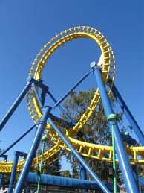
Loop the Loop
Take 1,2,&3
Notes:
The 1st attempt at the loop the loop
France- 1819
Name- Centrifuge Railway
Basic idea- car travels through circle shaped loop
(nothing but) Centrifugal force holding car to track
Centrifugal force= a force that draws a rotating body away from the center of rotation sen-trif-i-cul
^ caused by inertia
Government officials quickly put this idea to death after only one accident
Second attempt
1850’s
Name- “The Flip flap Railway”
Problem- Force was too strong/ snapped necks
Solution- Ride was built in oval form
Alright from safety standpoint/ bad from profit
This coaster didn’t make the hall of fame then just dropped out of existence alltogether
Third attempt- finally got it right
More oval then previous 2 coasters
Designers- Arrow & Intiman
Steel track- designed to go upside down
Very popular

Slide 7
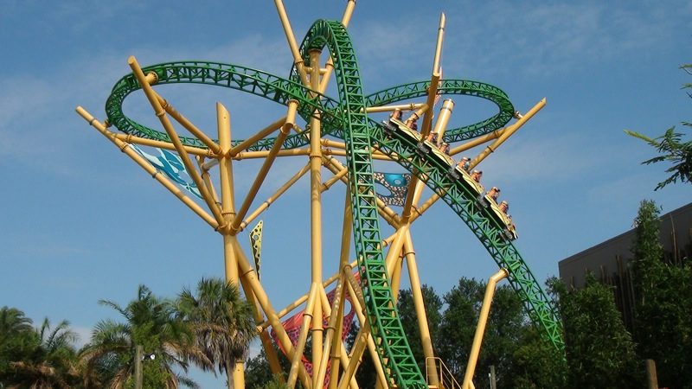
People and Companies
1920’s
Disney
Sea World
Notes:
1920’s
John A Miller
Famous coaster designer in 1920’s
Created the up stop wheel system
^ ensures the coaster wont leave the tracks
Considered to be the “Thomas Edison” of the roller coasters
Designed over 60 coasters
The 1920s were considered the “roaring 20’s” because of how popular coasters weree
about 2000 roller coasters were in the USA
There was about 1 coaster in every major city
^ this trend did not last too long
The great depression& world war two ended it
Coaster became a novelty item- memory
Disney
Disney is what got coasters popular again
1955- Disney world opened
One of the 1st real popular theme parks
Barley any wood coasters in Disney, even to this day
Matterhorn- built by Arrow, introduced by Disney 1959
^ Worlds first major tubular steel roller coaster
Tubular steel coaster= coaster with tubular steel tracks, these tracks consist of a pair of long steel tubes.
^hits speed of 18mph
Sea World- primary source
A company that has many parks across America
Bush Gardens Tampa Florida
According to my primary source- Diana R. from the Orlando contact center (OCC) Their newest roller coaster is called the Cheetah Hunt.
^ Length- 4,000ft. Height- 102 ft. Max speed- 60mph Time- 3.5 min. Force- 4g’s
Diana R. from the OCC also stated that the Bush Gardens is coming out with a ride called the “Falcunsfury”
^coming out late this spring
Drop- 300ft
^ Tallest ride in bush gardens
^ Tallest freestanding dropped tower in north america
URL to cheetah hunt pic- http://www.themeparkreview.com/parks/pimages/Busch_Gardens_Africa/Cheetah_Hunt_Media_Day/cheetah_hunt_media_01a.jpg

Slide 8
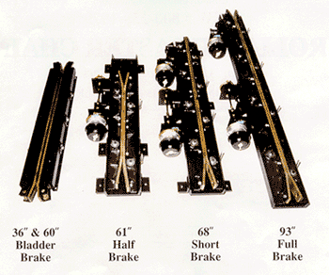
How it Works
Potential/Kinetic Energy
Brakes
Lift
Chain dog
Notes:
POTENTIAL&KINETIC ENERGY are the basic components on how a roller coaster works
Kinetic- energy that a body has by virtue of being in motion
Potential- the energy possessed by a body that has virtue of its position relative to others, stresses within itself, electric charge, and other factors.
The potential energy you build going up the hill can be released as kinetic energy, the energy of motion that takes you down the hill. (CREATIVE?)
On a coaster, the maximum kinetic energy is built riding up the first steep incline, pulled by a chain or cable cord. The maximum potential energy is on the first big drop.
The concept of potential energy, often referred to as energy of position, is very simple: As the coaster gets higher in the air, gravity can pull it down a greater distance.
Gravity and inertia work together to keep the coaster car in motion.
Acceleration is the rate of change in velocity.
Velocity is the speed in a given direction
Acceleration relates to roller coasters because, the more force applied to the chain pulley system, the greater the acceleration of the coaster.
Velocity is used in a roller coaster because when the chain pulley system pulls the coaster car up the hill, the coasters velocity is changed.
SHOW CREATIVE
BRAKES -one of most important parts of coaster
-not built into car itself, built into track
-When the train needs to come to a stop, a computer operates a hydraulic system that closes these clamps to stop the train.
-Hydraulic system- Force that is applied at one point is transmitted to another point using an incompressible fluid
The clamps to the brake close in on verticle metal fins that run under train. This gradually slows down train
Chain lift- used on wooden, pulls coaster up 1st hill
-At the top of a hill there is a gear, the chain is secured in a loop around the gear.
-There is another gear at the bottom of the hill, which is turned on by a simple motor.
-Similar to a conveyer belt, the motor at the bottom of the hill turns the chain loop so it continuously moves up the hill.
Cord- used on steel
^both loacated under track
CHAIN DOG- keeps cars down to track
Coaster grips onto chain with several chain dogs, sturdy with hinged hooks
The chain dogs catch onto chain links when the train rolls to the bottom of the hill.
-At the peak of the hill, the chain dog is released and the train starts its decent down the hill.
-Almost all the materials for STEEL coasters are shipped to job cites in sections on a truck, they are made in a factory
The materials on a wooden coaster are usually shipped to the cite as unfinished lumber
^the individual pieces are assembled and cut on cite.
-the actaul materials used for a RC vary beatween each type of RC

Slide 9
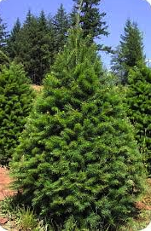
Materials
Wood or Steel Materials
Notes:
-A RA is either made up of wood or steal
-Type of wood used for WRC- usually douglas fir or southern yellow pine (in pic- douglass fur)
-The wooden components of a wood coaster are supported on concrete foundations and are joined with many nails and bolts
-Wood coasters use massive wooden trestle-style structures to support the track above the ground
-Steel coasters may use thin, trestle-style to support the track, or they may use thick tubular supports.
-All exposed steel surfaces are painted SRC on both wooden and steel roller coasters the track and chain lift are made out of steel.
-A different manufacturing process takes place, depending on the type of coaster

Slide 10
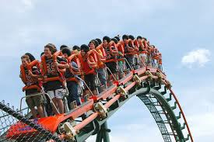
Manufacturing process
Construction
Future
Notes:
-physical construction of a roller coaster may take place in factory or on the amusment park site, depending on type & size of RC
-for most coasters, the sections are built in factory then trucked to site & put together
-most wooden are bulit piece by piece on site, and not in factory
-before any RC an be installed, the are where it will be built must be cleared & prepeaired
-site is usually prepaired off-season, inn other words, when site is closed
-3 holes are drilled or dug for support structure foundations
-once foundation is in place work can begein on the main support structure.
-for wood & steel coaster parts, the lower portions of the main supports are lifted by a crane and are attached to the connector plates.
-oncce the lower support structure is in place, they may be temporarily held in place, while upper sections are lifted into place and connected
-this work will continue until the main support structure is in place.
-when the main support structure is instaled, the coaster is ready for the track.
For steal coaster, after the track I brought on the site, sections of the track are lifted into place, then the ends are slid together.
The sections are bolted to each other and to the main support structure.
For wood coasters, “six to eight layers of flat wood boards are installed lengthways on top of tie beams in two rows to form a laminated base for the rails. The rails themselves are formed from long and flat strips of steel screwed to the wood base
electrical wiring is put in for the lighting, this can only be done when the main support structure is completed.
coaster is then painted, and additional sign and landscaping is installed
FUTURE
-In the future, Roller coasters are predicted to have complicated designs that feature both fear and excitement.
-There will be multiple loops, climbs, and drops with curves that interlope with each other.
-. Also there will be both group and single group cars that ride on the track
-These futuristic coasters will be run entirely on computers and will feature giant loops that people are only able to survive because of designs that are very carefully calculated
-Another type of coaster that might be seen in the future is one that hangs upside down on the track
(pic)
-The cars will be Ridgeley attached and will not be able to swing side to side.
-

Slide 11
Impact
Safety
Cost
Notes:
-One of the elements that makes the RC so popular is that they give the rider a sense of fear/excitement
-but there tends to be some question weather the rider is actually safe
-According to the International Association of Amusement Parks and Attractions, 335 million ppl visited U.S theme parks in 2006 and only 6,500 of those people needed medical attention due to a roller coaster
-Only about 130 of these people required overnight hospalization
-This means that the chances of getting injured on a roller coaster are one in 25 million
-In 2003, the Brain Injury Institute of America released a study that stated that ‘the risk of brain injury from a roller coaster is not in the rides, but in the rider.”
-This study examined six fatal injuries, and all have been caused by brain conditions that the rider had.
-Roller coasters today are very reliable and safe.
-The cable cord and chain on a coaster is frequently changed, usually about once a month.
-Once on a coaster, a rider is either secured in place by a lap bar or an over-the-shoulder harness.
-A shockingly low number of four point four deaths per year in the U.S caused are amusement park rides.
-Other fatal accidents are caused on behalf of the passenger.
-The cost of a roller coaster is getting increasingly higher as roller coasters become more advanced.
-Six Flags Amusement Park and the Cedar Fir are the two largest independent amusement-park operations in the U.S. Each generates almost one billion dollars a year in revenue.
-Some of the newest steal roller coaster cost over 20 million dollars alone just to build them.
-Then there is additional cost the amusement park has to pay, such as to replace the cable or to re-paint the structure.
-Cedar point is the world’s first 200 foot coaster. It costs about 45.99 dollars for one-day-admission.
-Usually the bigger, more popular parks tend to be pricier than smaller parks.

Slide 12
Roller Coasters
Notes:
Click, click, click. The roller coaster slowly approaches its peak. The rider’s adrenalin is rushing; their heart is pounding out of their chest. Suddenly there is a pause, the coaster reaches the peak. The coaster then rushes downs the drop. Everyone throws their arms up and screams. Roller coasters are thrill seeking adventure rides that are used all over the world today for a source of fear and excitement. Imagine what we would do without them?
Good morning, my name is marisa carlucci and my exhebition topic is on roller coaster.

Slide 13
Citations
Brakes. N.d. Costasur, Inc. Web. 8 May 2014. <http://www.costasurinc.com/brakes.htm>.
Cheetah Hunt. N.d. Theme Park Review. Web. 8 May 2014. http://www.themeparkreview.com/parks/photo.php?pageid=53&linkid=10408
Douglas Fir. N.d. Familys Making Memories for Generations. Web. 8 May 2014. http://www.wyckoffs.com/douglas_fir_christmas_tree.htm
French Weather-proof Slides. N.d. Entertainment Desighner. Web. <http://entertainmentdesigner.com/history-of-theme-parks/the-history-of-roller-coasters-the-ice-slides-of-russia-inspire-first-roller-coaster/>.
Loop the Loop. N.d. Loop Roller Coaster Curve Yellow. Web. 8 May 2014. <http://www.cepolina.com/loop-roller-coaster-curve-yellow.html>.
Russian Ice Slides. N.d. Entertainment Desighner. Web. 8 May 2014. <http://pabook.libraries.psu.edu/palitmap/SwitchbackIceSlide.jpg>.
Switchback. N.d. Matlock Bath: Derwent Gardens - The Switchback, (1) Rise & Fall. Web. 8 May 2014. <http://www.andrewsgen.com/matlock/pix/matlockbath_derwentgardens01_switchback.htm>.

